Slide 1

Huazhong University of Science and Technology
The Department of Electronics and Information Engineering
Electronic Circuit Analysis and Design
Electronic Circuit Analysis and Design
Dr. Tianping Deng
Email: dengtp@hust.edu.cn

Slide 2
Contents
PART 1 SEMICONDUCTOR DEVICES AND BASIC APPLICATIONS
Chapter 1 Semiconductor Materials and Diodes
Chapter 2 Diode Circuits
Chapter 3 The Field-Effect Transistor
Chapter 4 Basic FET Amplifiers
Chapter 5 The Bipolar Junction Transistor
Chapter 6 Basic BJT Amplifiers
Chapter 7 Frequency Response
Chapter 8 Output Stages and Power Amplifiers
PART 2 ANALOG ELECTRONICS
Chapter 9 Ideal Operational Amplifiers and Op-Amp Circuits
Chapter 10 Integrated Circuit Biasing and Active Loads
Chapter 11 Differential and Multistage Amplifiers
Chapter 12 Feedback and Stability
Chapter 13 Operational Amplifier Circuits
Chapter 14 Nonideal Effects in Operational Amplifier Circuits
Chapter 15 Applications and Design of Integrated Circuits
Chapter 3 The Field-Effect Transistor

Slide 3
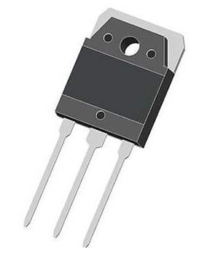
3.2 MOSFET DC CIRCUIT ANALYSIS
3.2.1 Common-Source circuit
3.2.2 Load Line and Modes of Operations
3.2.3 Common MOSFET Configurations :DC analysis

Slide 4
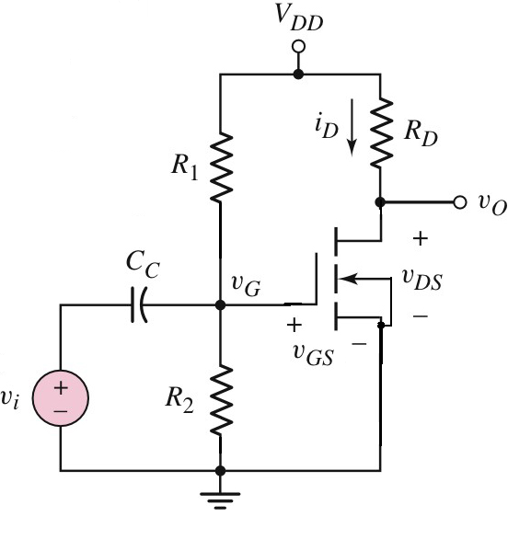
3.2.1 Common-Source circuit
Coupling capacitor: Acting as a short circuit in ac analysis, and as an open circuit in dc analysis
NMOS Common-Source Circuit

Slide 5
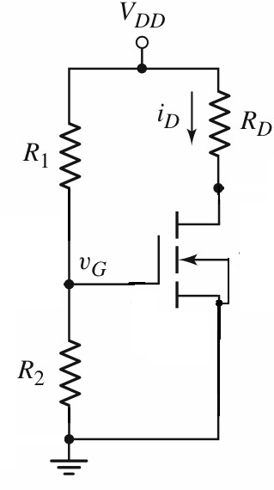
3.2.1 Common-Source circuit
Open
DC circuit
Set zero

Slide 6
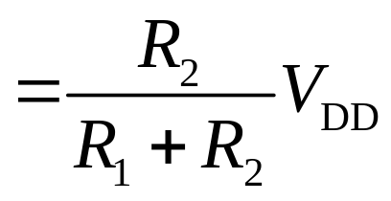
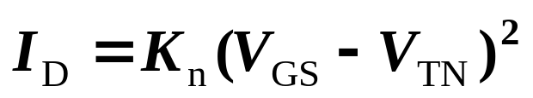
3.2.1 Common-Source circuit
V_{GQ} =V_{GSQ}
If V_{GS}>V_{TN}
? Which region?
V_{DS} >V_{GS}−V_{TN}
0
Transistor is in saturation region.
V_{DS} =V_{DD}- I_{D} R_{D}

Slide 7









3.2.1 Common-Source circuit
V_{TN}=1V, K_{n}=0.1mA/V²
Find the power dissipated in the MOSFET.
V_{GQ} =V_{GSQ}
Suppose the FET is working in saturation region.
V_{GS}>V_{TN}
V_{DS} =V_{DD}- I_{D} R_{D}
V_{DS} >V_{GS}−V_{TN}
saturation
Work in which region?

Slide 8



3.2.1 Common-Source circuit
V_{TN}=1V, K_{n}=0.1mA/V²
Find the power dissipated in the MOSFET.
V_{GQ} =V_{GSQ}
Suppose the FET is working in saturation region.
V_{GS}>V_{TN}
V_{DS} =V_{DD}- I_{D} R_{D}
V_{DS} <V_{GS}−V_{TN}
Work in which region?
Nonsaturation

Slide 9




3.2.1 Common-Source circuit
V_{TN}=1V, K_{n}=0.1mA/V²
Find the power dissipated in the MOSFET.
V_{GQ} =V_{GSQ}
Suppose the FET is working in saturation region.
V_{DS} =V_{DD}- I_{D} R_{D}
V_{DS} =V_{DD}- I_{D} (R_{D} + R_{S})

Slide 10








3.2.1 Common-Source circuit
V_{TN}=1V, K_{n}=1mA/V²
Find the power dissipated in the MOSFET.
V_{GQ}
=3V
V_{SQ} =I_{D} R_{S}
=I_{D}
Suppose the FET is working in saturation region.
I_{D} =1(3-I_{D}-1)²
V_{GS}>V_{TN}
V_{DS} =V_{DD}- I_{D} (R_{D} + R_{S})
V_{DS} >V_{GS}−V_{TN}
=5- 1 (1 + 1)
=3V
saturation

Slide 11

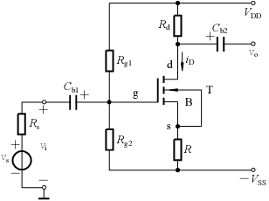
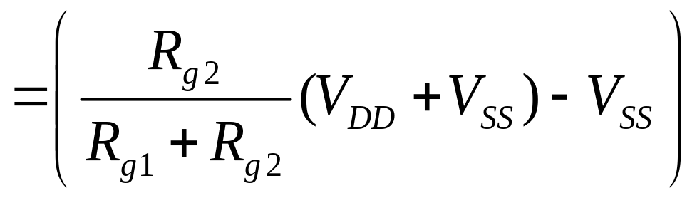
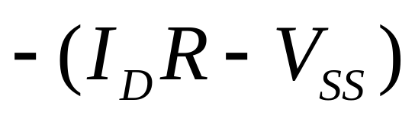
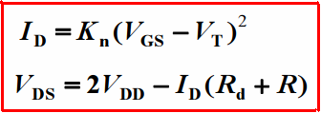

3.2.1 Common-Source circuit
If in saturation region.

Slide 12
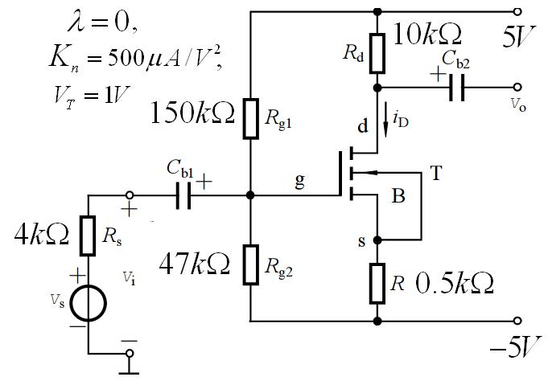
3.2.1 Common-Source circuit
Find Q－point

Slide 13
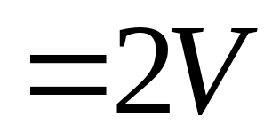
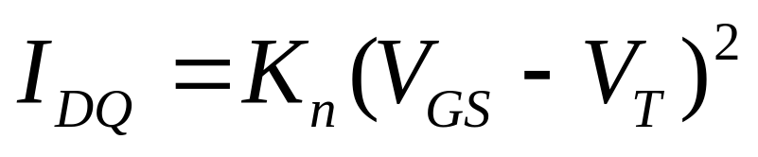
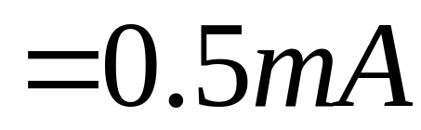
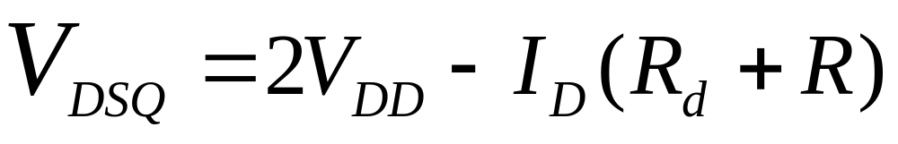
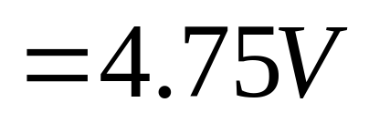
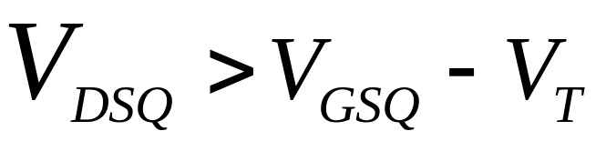


Work in saturation region.

Slide 14
3.2.1 Common-Source circuit
Problem-Solving Technique:
NMOSFET DC Analysis
Assume the transistor is in saturation.
  V_{GS} > V_{TN}, I_{D} > 0, & V_{DS} ≥ V_{DS}(sat)
Analyze circuit using saturation I-V relations.
Evaluate resulting bias condition of transistor.
  If V_{GS} < V_{TN}, transistor is likely in cutoff
  If V_{DS} < V_{DS}(sat), transistor is likely in nonsaturation region
If initial assumption is proven incorrect, make new assumption and repeat Steps 2 and 3.

Slide 15

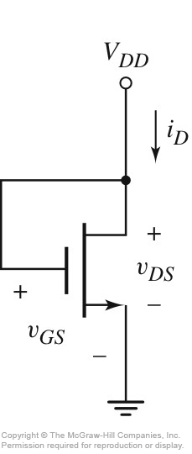
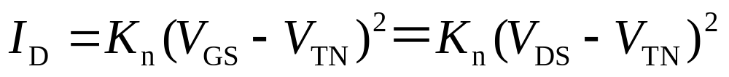
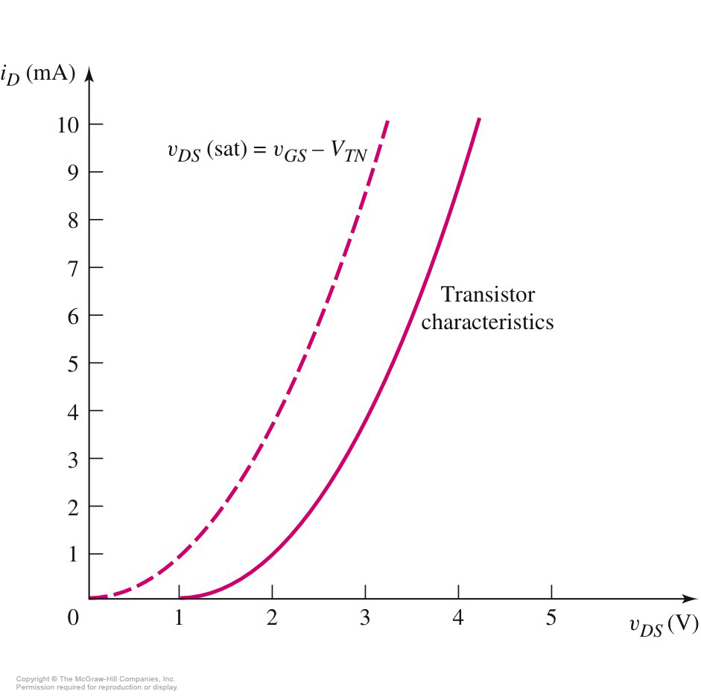

Enhancement Load Device
V_{TN}=1V, K_{n}=1mA/V²
See the example P156.

Slide 16
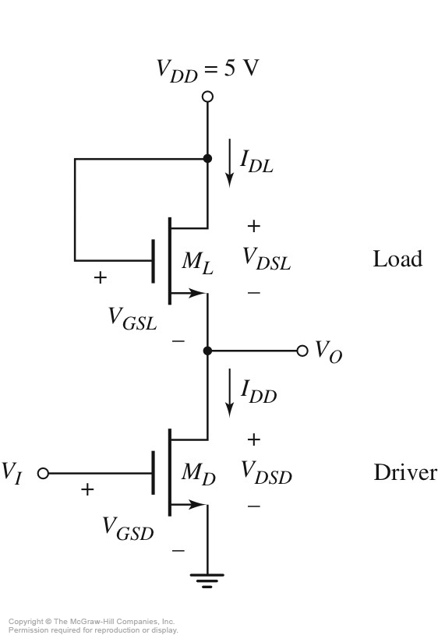
3.2.1 Common-Source circuit
Circuit with Enhancement Load Device and NMOS Driver
M_{L} is always in saturation.
M_{D} can be biased either in saturation or nonsaturation region.

Slide 17
Questions
and
Answers

